Slide 1

CROP PRODUCTION ANALYSIS
- Maal Subiksha M

Slide 2
INTRODUCTION
Crop production analysis is a crucial component of agricultural research and policy-making. It involves the systematic examination of various factors influencing crop yield, production trends, and distribution across different regions and time periods.
The Crop Production Dashboard provides a comprehensive analysis of crop production data to uncover valuable insights about agricultural productivity across various dimensions. This analysis is vital for understanding trends, identifying key contributors to crop production, and making informed decisions for future agricultural planning.

Slide 3
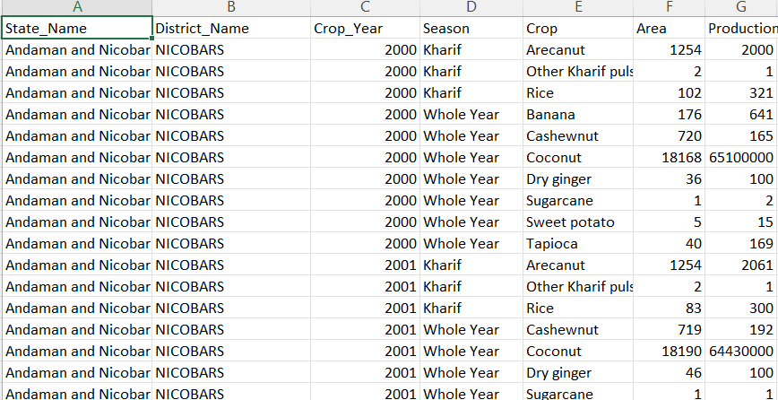
DATASET DESCRIPTION

Slide 4
Technology used
Jupyter Notebook (Python Kernel)
Streamlit Module – to create an interactive dashboard setup
Visualization Libraries : seaborn, matplotlib
Numpy and Pandas framework

Slide 5
MAIN METRICS INVOLVED
Top 10 Districts by Crop Production
Insight: Identifies districts that are major contributors to crop production.
Insight Derived: Focuses on district-level agricultural strategies, identifies key production centers, and assesses regional agricultural competitiveness.
Rice Production Over Time
Insight: Focuses specifically on the production trends for rice.
Insight Derived: Understands specific crop dynamics, such as rice production trends, factors influencing rice cultivation, and market impacts of rice production fluctuations.
Heatmap of Production by State and Year
Insight: Provides a visual representation of production across states and years.
Insight Derived: Identifies regional production patterns, compares production intensities across states and years, and assesses state-level contributions to national production.

Slide 6
Stacked Area Chart of Crop Production Over Time
Insight: Shows how different crops contribute to total production over time.
Insight Derived: Analyzes crop diversification trends, identifies dominant crops in different periods, and assesses changes in crop distribution over time.
Multiple Line Chart of Crop Production Over Time
Insight: Visualizes production trends for multiple crops simultaneously.
Insight Derived: Compares production trajectories across crops, identifies interdependencies or competition between crops, and assesses crop-specific market dynamics.
Production by Crop Type (Bar Chart)
Insight: Highlights production levels for different crop types.
Insight Derived: Identifies major crop categories contributing to overall production, assesses market dominance of specific crop types, and supports crop-specific policy decisions.

Slide 7
Total Crop Production Over Time
Insight: This plot shows the overall trend of crop production over the years.
Insight Derived: Identify long-term production trends, periods of growth or decline in production, and potential factors influencing these trends over time.
Top 10 States by Crop Production
Insight: Identifies which states contribute the most to overall crop production.
Insight Derived: Helps focus agricultural policies, investments, and resource allocation on states with high production, understand regional disparities, and potentially identify best practices for production.
Total Crop Production by Season
Insight: Shows how production varies across different seasons.
Insight Derived: Understand seasonal patterns in crop production, optimize planting and harvesting schedules, and anticipate seasonal variations in supply and demand.

Slide 8
Scatter Plot with Regression Line of Area vs Production
Insight: Shows the relationship between cultivated area and crop production.
Insight Derived: Analyzes the efficiency of land use, identifies optimal land productivity levels, and assesses the impact of area expansion or contraction on production.
Production Distribution Across Crops (Box Plot)
Insight: Displays the distribution of production levels across different crops.
Insight Derived: Assesses variability in production levels between crops, identifies crops with consistent or volatile production patterns, and supports risk management in crop diversification.
Time Series of Production for Top Crops
Insight: Tracks production trends for the top crops over time.
Insight Derived: Identifies leading crop performers, assesses long-term crop viability and market trends, and supports strategic planning for crop management and resource allocation.

Slide 9
Correlation Heatmap
Insight: Shows correlations between production, area, and yield.
Insight Derived: Identifies relationships between production metrics, assesses factors influencing production efficiency, and informs integrated crop management strategies.
Yield Distribution Across Seasons (Violin Plot)
Insight: Visualizes yield variations across different seasons.
Insight Derived: Analyzes seasonal yield patterns, identifies optimal planting seasons for maximizing yield, and supports seasonal yield forecasting and management.
Average Crop Production per Year
Insight: Shows the average production levels annually.
Insight Derived: Helps track average productivity trends, identify outliers or anomalies in production, and assess the overall efficiency of agricultural practices over time.

Slide 10
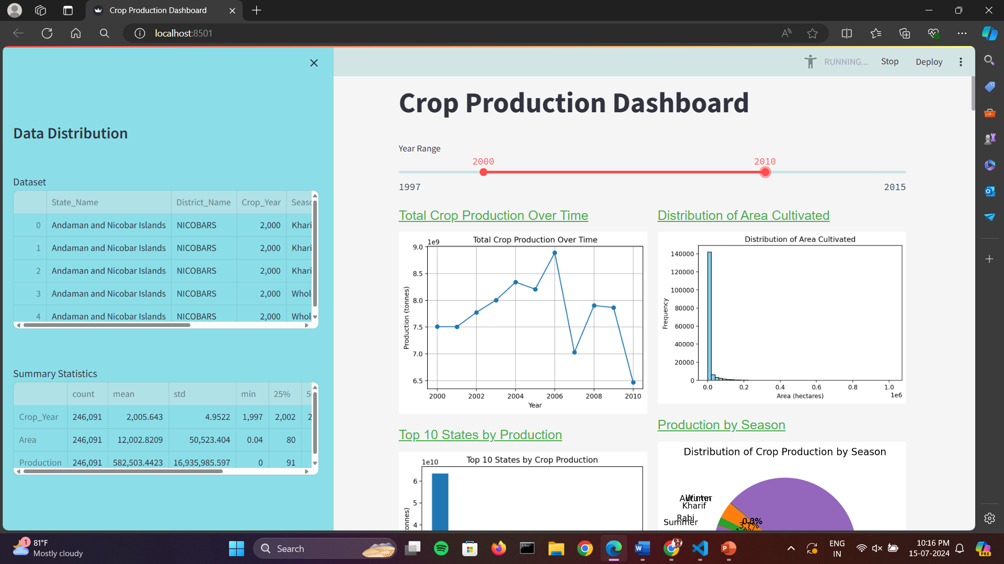
DASHBOARD DESIGN

Slide 11
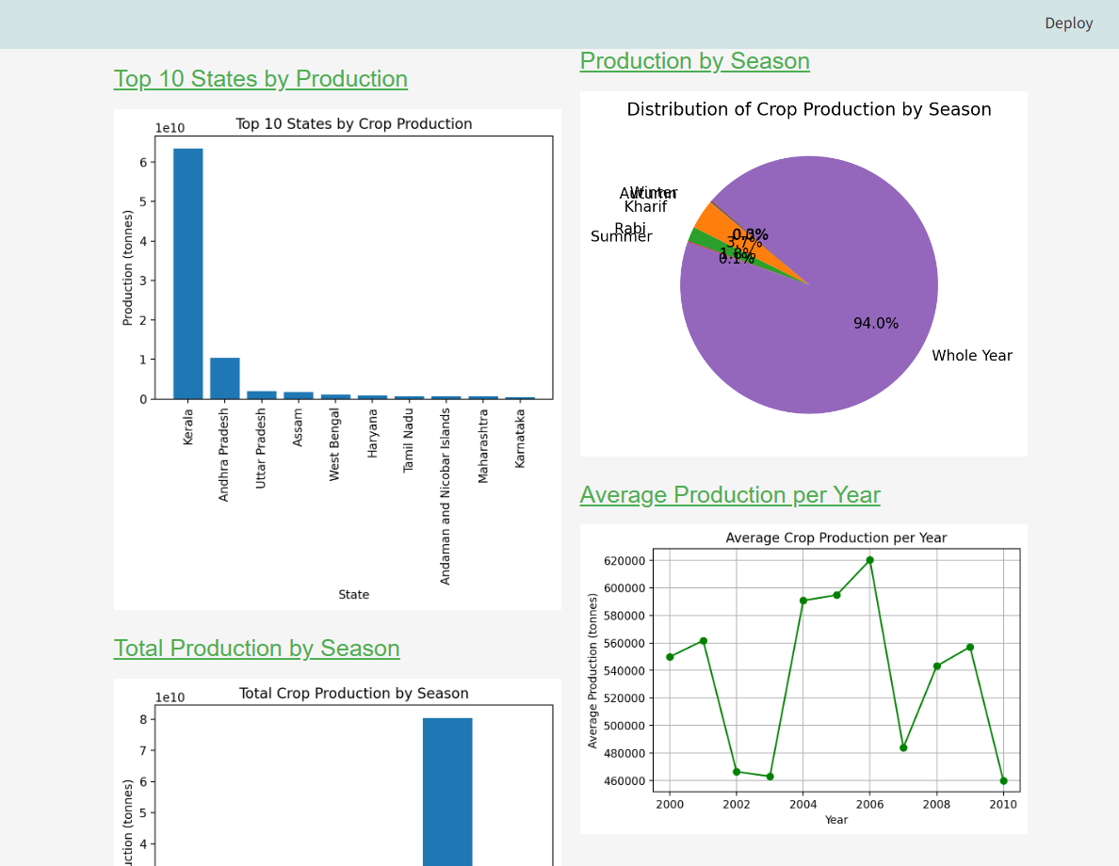

Slide 12
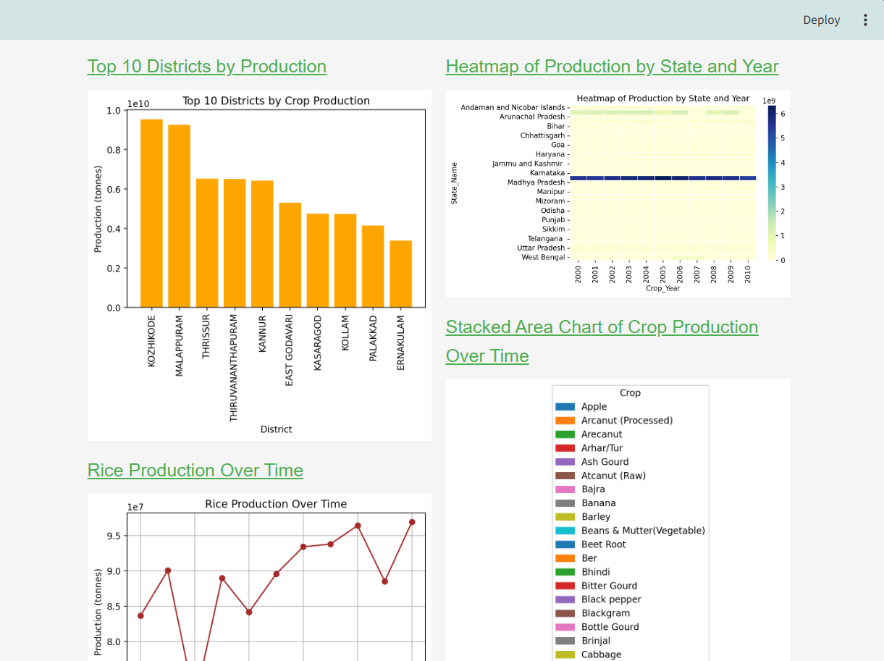
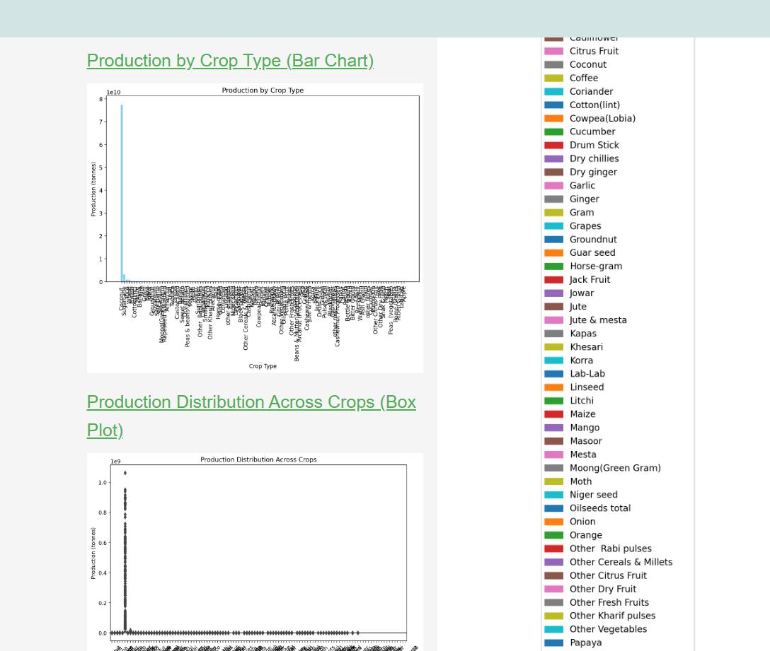

Slide 13
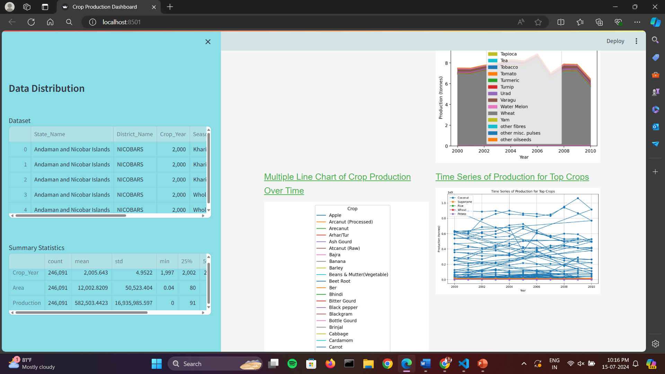
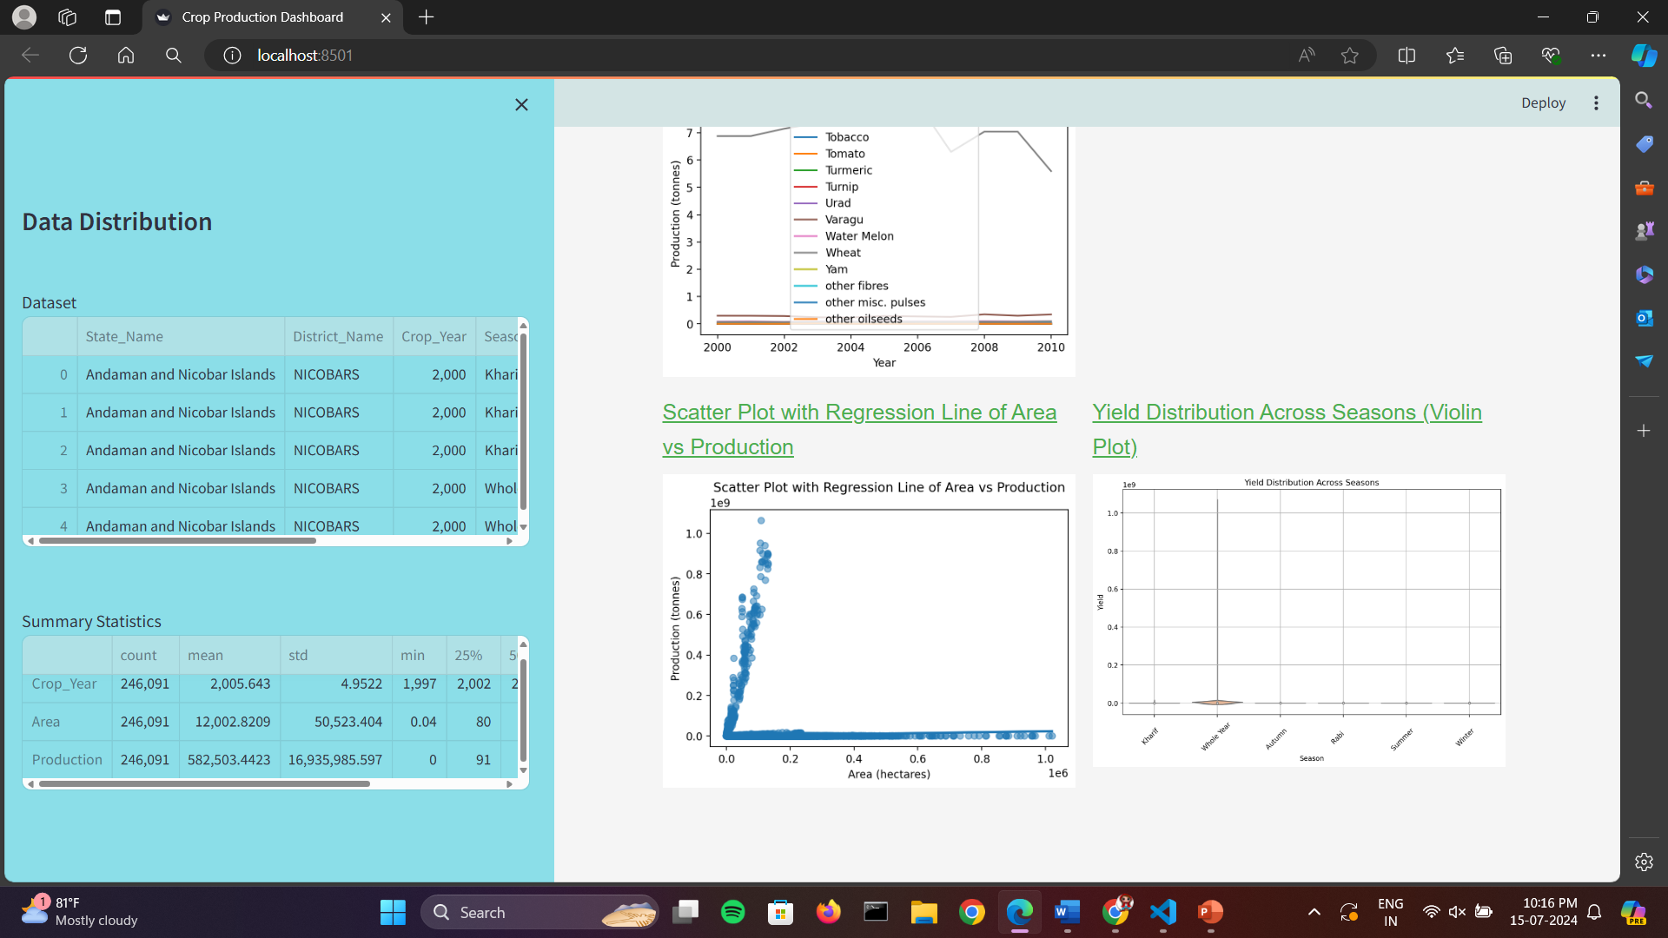

Slide 14
THANK YOU ☺

